Slide 1
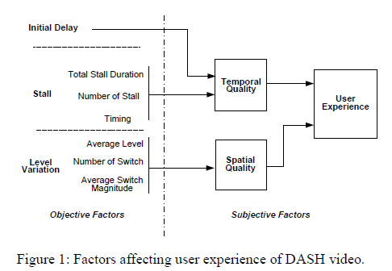
2nd round of subjective test
Goal: Deriving overall UE model: MOS = f(I_{ID}, I_{ST}, I_{LV})
Impairment due to Initial Delay
Impairment due to Level Variation
Impairment due to Stall

Slide 2
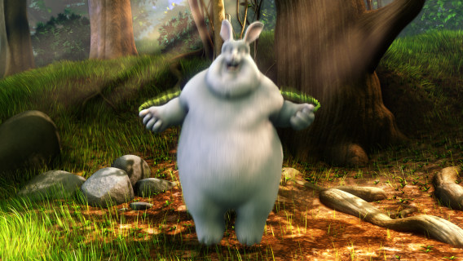

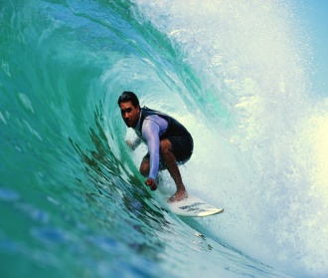
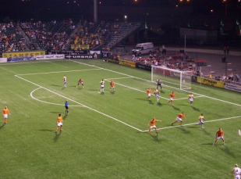
Summary of Round II subjective Test (1)
116 test videos are generated:
48 videos for deriving combined model (multiple impairment happen simultaneously)
10 videos for deriving stall impairment function again
(48+10) * 2 = 116
.
Medium motion content
High motion content

Slide 3
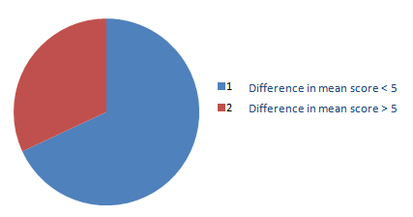
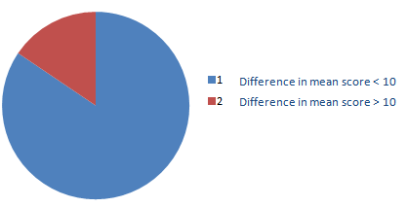
Summary of Round II subjective Test (2)
At UCSD, totally 30 testers participated (2 outliers)
At Qualcomm, totally 21 testers participated (1 outlier).
In general, the average evaluation of UCSD test results are similar to Qualcomm test results:
------ Out of totally 116 videos, there are 73 videos satisfying:
ABS {mean(UCSD testers) - mean(Qualcomm testers} < 5
there are 98 videos satisfying:
ABS {mean(UCSD testers) - mean(Qualcomm testers} < 10
16%
37%
63%
84%

Slide 4
Qualcomm Result
Scores of Test Video A
(similar average score , similar deviation )
Qualcomm Result
Qualcomm Result
Scores of Test Video B
(Qualcomm result has higher deviation )
Scores of Test Video C
(UCSD result has higher deviation )

Slide 5
Impairment due to Stall: I_{ST}
Total Stall Duration | Number of Stalls | Impairment
4 seconds | 1 | 10.5
 | 2 | 17.8
 | 4 | 22.9
8 seconds | 1 | 25.5
 | 2 | 22.1
 | 3 | 27.3
 | 8 | 36.2
12 seconds | 1 | 38
 | 3 | 31.5
 | 12 | 45
Total Stall Duration | Number of Stalls | Impairment
4 seconds | 1 | 19.1
 | 2 | 24.8
 | 4 | 34.3
8 seconds | 1 | 38.1
 | 2 | 30.3
 | 3 | 35.3
 | 8 | 48.5
12 seconds | 1 | 50.8
 | 3 | 42.5
 | 12 | 59.8
Medium Motion Video
High Motion Video
I_{ST}(medium motion ) < I_{ST}(high motion)
I_{ST}(a few medium stall ) < I_{ST}(a long stall) < I_{ST}(a lot of short stalls)

Slide 6
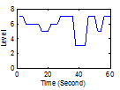



Overall Model : combine impairments
ID | Initial Delay | Stall | (I_{ID}, I_{ST}, I_{LV}) | I00-R
1 | 1s | No | (3, 0, 8) | 9.2
2 | 1s | No | (3, 0, 24) | 19.1
3 | 1s | No | (3, 0, 34) | 37
4 | 1s | No | (3,0, 30) | 28.2
5 | 1s | 2s, 2stall | (3, 10, 10) | 20.4
6 | 1s | 2s, 2 stall | (3, 10, 24) | 26
7 | 1s | 2s, 2 stall | (3, 10, 34) | 43
8 | 1s | 2s, 2 stall | (3, 10, 30) | 36.8
9 | 3s | 8s, 2 stall | (10, 22, 10) | 24
10 | 3s | 8s, 2 stall | (10, 22, 24) | 27.6
11 | 3s | 8s, 2 stall | (10, 22, 34) | 36
12 | 3s | 8s, 2 stall | (10, 22, 30) | 46
13 | 3s | 12s, 4 stall | (10, 36, 10) | 31
14 | 3s | 12s, 4 stall | (10, 36, 24) | 53
15 | 3s | 12s, 4 stall | (10, 36, 34) | 54.2
16 | 3s | 12s, 4 stall | (10, 36, 30) | 48
17 | 6s | No | (19, 0, 10) | 18.6
18 | 6s | No | (19, 0, 24) | 23.3
19 | 6s | No | (19, 0, 34) | 33.3
20 | 6s | No | (19, 0, 30) | 39
21 | 6s | 2s, 2 stall | (19, 10, 10) | 19
22 | 6s | 2s, 2 stall | (19, 10, 24) | 27
23 | 6s | 2s, 2 stall | (19, 10, 34) | 38.2
24 | 6s | 2s, 2 stall | (19, 10, 30) | 50.5
ID | Initial Delay | Stall | (I_{ID}, I_{ST}, I_{LV}) | 100-R
25 | 6s | 8s, 2 stall | (19, 22, 10) | 25
26 | 6s | 8s, 2 stall | (19, 22, 24) | 33
27 | 6s | 8s, 2 stall | (19, 22, 34) | 48.8
28 | 6s | 8s, 2 stall | (19,22, 30) | 58
29 | 6s | 12s, 4 stall | (19, 36, 10) | 36.4
30 | 6s | 12s, 4 stall | (19, 36, 24) | 40
31 | 6s | 12s, 4 stall | (19, 36, 34) | 46.4
32 | 6s | 12s, 4 stall | (19, 36, 30) | 43.9
33 | 10s | No | (32, 0, 10) | 15
34 | 10s | No | (32, 0, 24) | 20
35 | 10s | No | (32, 0, 34) | 39.1
36 | 10s | No | (32, 0, 30) | 29.7
37 | 10s | 2s, 2 stall | (32, 10, 10) | 20.2
38 | 10s | 2s, 2 stall | (32, 10, 24) | 28.8
39 | 10s | 2s, 2 stall | (32, 10, 34) | 49.2
40 | 10s | 2s, 2 stall | (32, 10, 30) | 49
41 | 10s | 8s, 2 stall | (32, 22, 10) | 19.2
42 | 10s | 8s, 2 stall | (32, 22, 24) | 29.2
43 | 10s | 8s, 2 stall | (32, 22, 34) | 47
44 | 10s | 8s, 2 stall | (32, 22, 30) | 46.2
45 | 10s | 12s, 4 stall | (32, 36, 10) | 25
46 | 10s | 12s, 4 stall | (32, 36, 24) | 40
47 | 10s | 12s, 4 stall | (32, 36, 34) | 59
48 | 10s | 12s, 4 stall | (32, 36, 30) | 57
Case 33
Case 18
Case 17
Case 40

Slide 7
Overall UE model: possible formula (1)
After obtaining the experiment results, we observe that when multiple impairments happen at the same time, the overall impairment people perceive is less than the sum of each individual impairment. Therefore we propose to use equation (2) to model the overall UE.
We use 60% of the experiment results for training, obtain the values of coefficients C1~C3 using linear regression method.
(1)
(2)
These cross-terms are used to compensate simultaneous impairments.
C₁ | C₂ | C₃
0.27 | 0.32 | 0.35

Slide 8
Validating the overall UE model
Predicted DASH-MOS
Subjective DASH-MOS
The correlation between subjective and predicted DASH-MOS is 0.86, MSE = 0.129.

Slide 9
The problem of this formula is: it gives equal weights to different impairments. But actually, when stall and level variation artifacts are prominent, viewers will usually “forget” the initial delay problem.

Slide 10
A possible alternative
Formula I:
Term A
Formula II:
Term B
Term C
Term B will try to cancel out term C when stall or level variation artifact is big.
Then there is a series of formulas to choose from:

Slide 11
Modify the formula to:
When I_{ID}, I_{ST} and I_{LV} are relatively small, the overall impairment will be close to the sum of them.
But when I_{ST} and I_{LV} are big, peoples’ perception will be dominated by them and forget I_{ID}.
Term B
When I_{ST} and I_{LV} are small, Term B is small, and R is close to 100- I_{ID}-I_{ST}-I_{LV}
When I_{ST} or I_{LV} is big, Term B is big, Term B will be close to I_{ID} , so the artifact due to initial delay will be cancelled.
C₁ | C₂
0.17 | 0.31
Subjective DASH-MOS
The correlation between subjective and predicted DASH-MOS is 0.91, MSE = 0.082.

Slide 12
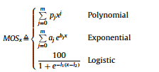
I have also tried the following models:
Model | Correlation Coefficient | MSE
polynomial | 0.78 | 0.46
exponential | 0.74 | 0.68
logistic | 0.68 | 0.85
SVM | 0.88 | 0.106

